Slide 1
電腦視覺與深度學習 (Computer Vision and Deep Learning) Homework 1
TA:
Mark : 29A7882zz@gmail.com
Office Hour: 19:00~21:00, Mon.
09:00~11:00, Wed.
At CSIE 9F Robotics Lab.

Slide 2
Notices (1/2)
Copy homework is strictly prohibited!! Penalty: Grade will be zero for both persons!!
If the code can’t run, you can come to our Lab within one week and show that your programming can work. Otherwise you will get zero!!
Due date => 2019/11/06 (Wed.) 23:59:59
No delay. If you submit homework after deadline, you will get 0.
Upload to => 140.116.154.1 -> Upload/Homework/HW1
User ID: cvdl2019 Password: cvdl2019
Format
Filename: Hw1_StudentID_Name_Version.rar
Ex: Hw1_F71234567_林小明_v1.rar
If you want to update your file, you should update your version to be v2, ex: Hw1_F71234567_林小明_v2.rar
Content: project folder*( including the pictures ) *note: remove your “Debug” folder to reduce file size

Slide 3
Notices (2/2)
C++ (check MFC guide in ftp)
OpenCV 3.3.1 (https://opencv.org/release.html)
Visual Studio 2015 (download from http://www.cc.ncku.edu.tw/download/)
UI framework: MFC
Python
Python 3.7 (https://www.python.org/downloads/)
Tensorflow 2.0 / PyTorch 1.3.0
opencv-contrib-python (3.4.2.17)
Matplotlib 3.1.1
UI framework: pyqt5 (5.11.3)

Slide 4
Grading
0. Homework Format
1. (10%, reference) Camera Calibration (出題：Jang)
1.1 Corner detection (0%)
1.2 Find the intrinsic matrix (0%)
1.3 Find the extrinsic matrix (0%)
1.4 Find the distortion matrix (0%)
2. (20%) Augmented Reality (出題：Jang)
3. (10%, reference) Image Transformation (出題：YiYuan)
3.1 Rotation, scaling, translation (0%)
3.2 Perspective transform (0%)
4. (10%, reference) Find Contour (出題：Rex)
5. (50%) Training Cifar-10 classifier using LeNet (出題：Michael)

Slide 5
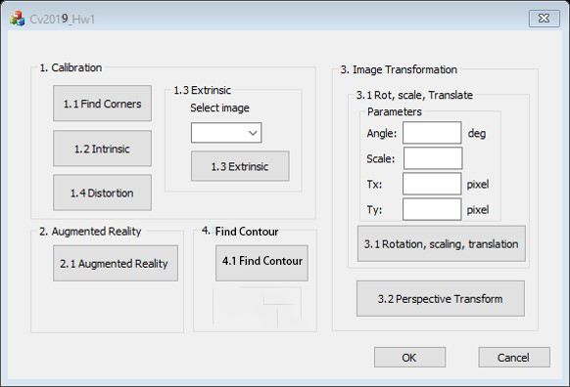
0. Homework Format
Use MFC to create GUI like following picture

Slide 6
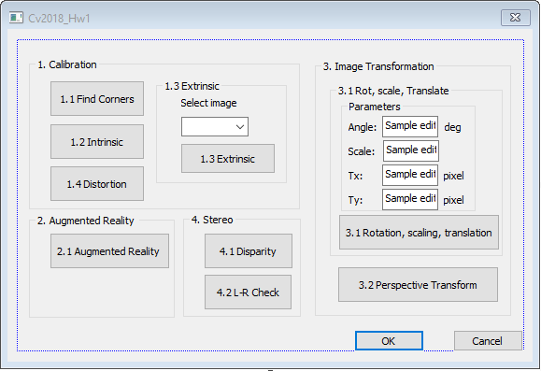
1. Camera Calibration (出題：Jang)
1.1 Corner detection
1.2 Find the intrinsic matrix
1.3 Find the extrinsic matrix
1.4 Find the distortion matrix

Slide 7
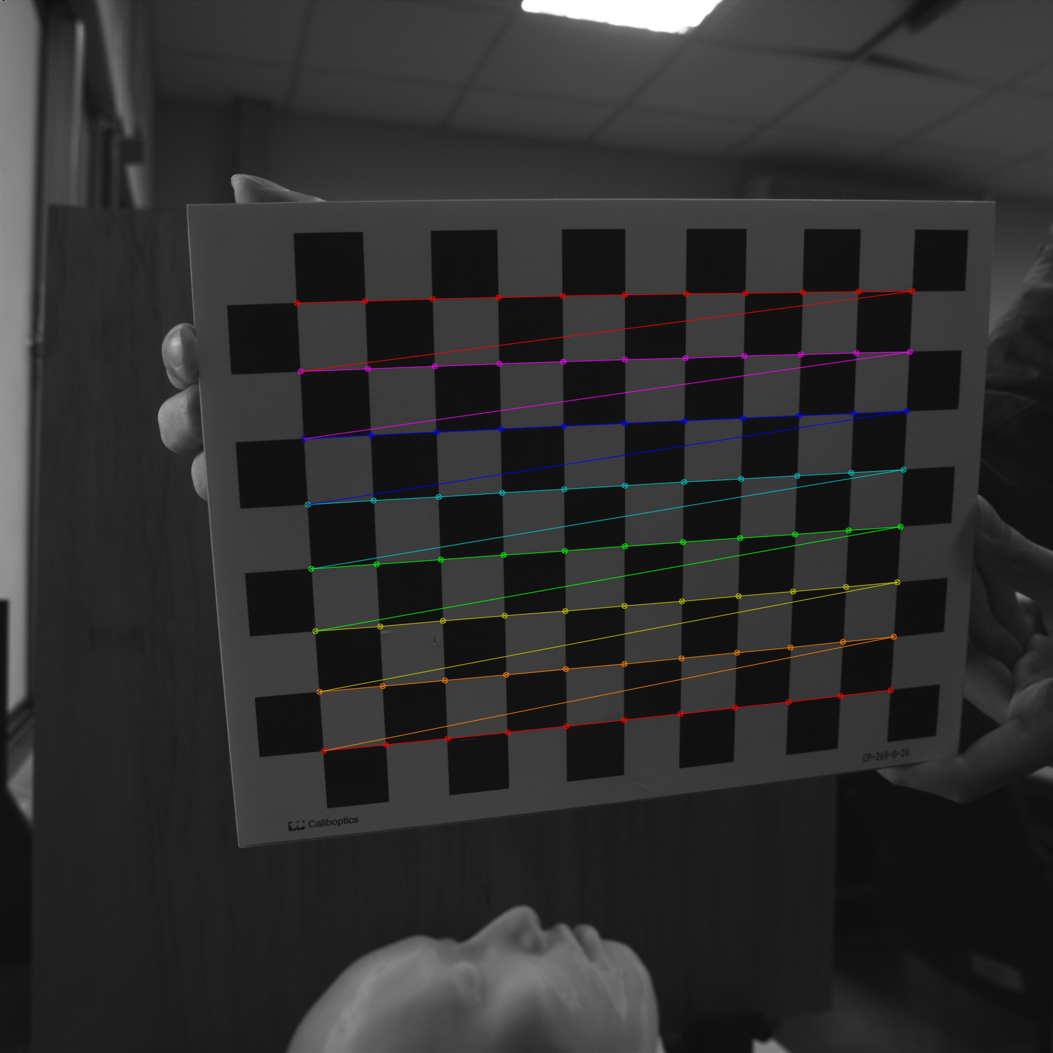
1.1 Corner Detection (解題:Max)
Given: 15 images, 1.bmp ~ 15.bmp
Q: 1) Find and draw the corners on the chessboard for each image.
2) Click button “1.1” to show the result.
Hint :
OpenCV Textbook Chapter 11 (p. 398 ~ p. 399)
cvShowImage(…);
Ex:
7

Slide 8
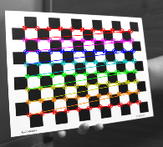
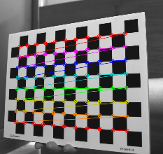
1.1 Corner detection (10%)
Given: 15 images, 1.bmp ~ 15.bmp
Q: Find the corners on the chessboard for every image and draw them.
Answer:
// imgs: 15 images, chess_size: rows and columns of the chessboard
// corners: corners of the chessboard
cv2.findChessboardCorners( image, PatternSize, corners, CALIB_CB_ADAPTIVE_THRESH | CALIB_CB_FAST_CHECK | CALIB_CB_NORMALIZE_IMAGE) --> retval, corners;
// found: Boolean result from findChessboardCorners
cv2.drawChessboardCorners( image, PatternSize, corners, found);
Notes:
There are two opencv functions for finding corners of chess boards.
One is findChessBoardCorners. To use it, we need images and size of chessboard.
We already have 15 images, right. And this chess_size variable means that size of rows and columns of chessboard, but it is only counted internal corners of chess board, so 11 columns and 8 rows are values we should put into the function.
Besides, the corners variable is an array containing coordinate of corners. When the function was running, corner data is saved in the memory.
And then, those three flag values are kind of options for finding corners,.. This is about adaptive thresholding to convert the image to black and white. And this makes finding corners faster. And this is normalizing the image gamma.
This function literally draws corners on the chessboard. Put an image, chess size, and corners array. And found is a Boolean value from the findChessboardCorners.
If finding corners is successful, the function return True which is Boolean value.
Of course you should make a loop which can run functions 15 times.
Below both images are the results.

Slide 9
Source Code
// Read the chess board images
names = sorted(os.listdir(_CALIBRATE_DIR), key=_KEY)
images = [cv2.imread(os.path.join(d, f), cv2.IMREAD_GRAYSCALE) for f in names]
// Convert RGB to GRAY
images = [cv2.cvtColor(i, cv2.COLOR_GRAY2RGB) for i in images]
// Find the chess board corners
all_retvals, all_corners = [cv2.findChessboardCorners(i, pattern_size, None) for i in images]
// Draw the corners on each images
images = [cv2.drawChessboardCorners(i, _PATTERN_SIZE, c, r)
for i, r, c in zip(images, all_retvals, all_corners)]
// Show the images
for n, i in zip(os.listdir(_CALIBRATE_DIR), images):
cv2.imshow(‘%s’%(n), i)
cv2.waitKey(0)

Slide 10
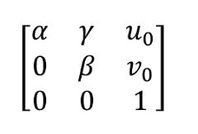
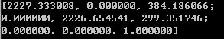
1.2 Find the Intrinsic Matrix (解題:Max)
Given: 15 images, 1.bmp ~ 15.bmp
Q: 1) Find the intrinsic matrix ():
2) Click button “1.2” and then show the result on the console window.
Output format:
Hint: OpenCV Textbook Chapter 11 (P.398 ~ p.400)
(Just an example)

Slide 11
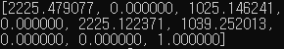
1.2 Find the Intrinsic Matrix (10%)
Given: 15 images, 1.bmp ~ 15.bmp
Q: 1) Find the intrinsic matrix ():
2) Click button “1.2” and then show the result on the console window.
Output format:
Answer:
retval, camera_matrix, distortion_coeffs, rvec, tvec = cv2.calibrateCamera(object_points, image_points, image_size, None, None)
Notes:
Second part of question1 is to get intrinsic matrix of a camera from 15 pictures.

Slide 12
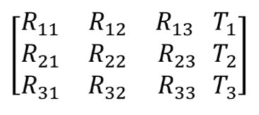
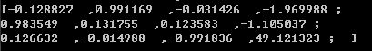
1.3 Find the Extrinsic Matrix (解題:Max)
Given: intrinsic parameters, distortion coefficients, and the list of 15 images
Q: 1) Find the extrinsic matrix of the chessboard for each of the 15 images, respectively:
2) Click button “1.3” and then show the result on the console window.
Output format:
Hint: OpenCV Textbook Chapter 11, p.370~402
(Just an example)
(1) List of numbers: 1~15
(2) Select 1, then 1.bmp will be applied, and so on

Slide 13
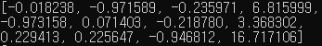
1.3 Find the Extrinsic Matrix (10%)
Given: intrinsic parameters, distortion coefficients, and the list of 15 images
Q: 1) Find the extrinsic matrix of the chessboard for 1 of the 15 images:
2) Click button “1.3” and then show the result on the console window.
Output format:
Answer:
// object_points: vectors of calibration pattern points
// image_points: vectors of the projections of calibration pattern points
retval, camera_matrix, distortion_coeffs, rvec, tvec = cv2.calibrateCamera(object_points, image_points, image_size, None, None)
Rotation_matrix = cv2.Rodrigues(r)
Extrinsic_matrix = np.hstack([R, t])
Notes:
So, we should find the extrinsic matrix.

Slide 14
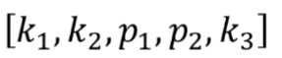
1.4 Find the Distortion Matrix (解題:Max)
Given: 15 images
Q: 1) Find the distortion matrix:
2) Click button “1.4” to show the result on the console window.
Output format:
Hint:
Distortion coefficients can be obtained simultaneously with intrinsic parameters
OpenCV Textbook Chapter 11 (P.398 ~ p.400)
(Just
an example)

Slide 15
1.4 Find the Distortion Matrix (10%)
Given: 15 images
Q: 1) Find the distortion matrix:
2) Click button “1.4” to show the result on the console window.
Output format:
Answer:
// object_points: vectors of calibration pattern points
// image_points: vectors of the projections of calibration pattern points
retval, camera_matrix, distortion_coeffs, rvec, tvec = cv2.calibrateCamera(object_points, image_points, image_size, None, None)

Slide 16
Source Code for Q1-2 ~ Q1-4
// Define object_points according to row and columns in chess board.
object_points = np.zeros((8*11, 3), np.float32)
object_points[:, :2] = np.mgrid[0:11, 0:8].T.reshape(-1, 2)
// Define image_points from corners find in question 1
corners = [np.squeeze(c, axis=1) for c in all_corners]
image_points = np.array(corners, dtype=np.float32)
// Define the shape of images
image_size = images[0].shape
// Find Camera matrix, distortion parameters
retval, c, d, r, t = cv2.calibrateCamera(object_points, image_points, image_size, None, None)
Camera matrix = c
distortion matrix = d
// Find extrinsic parameters
Rotation_matrix = cv2.Rodrigues(r)
Extrinsic_matrix = np.hstack([R, t)

Slide 17
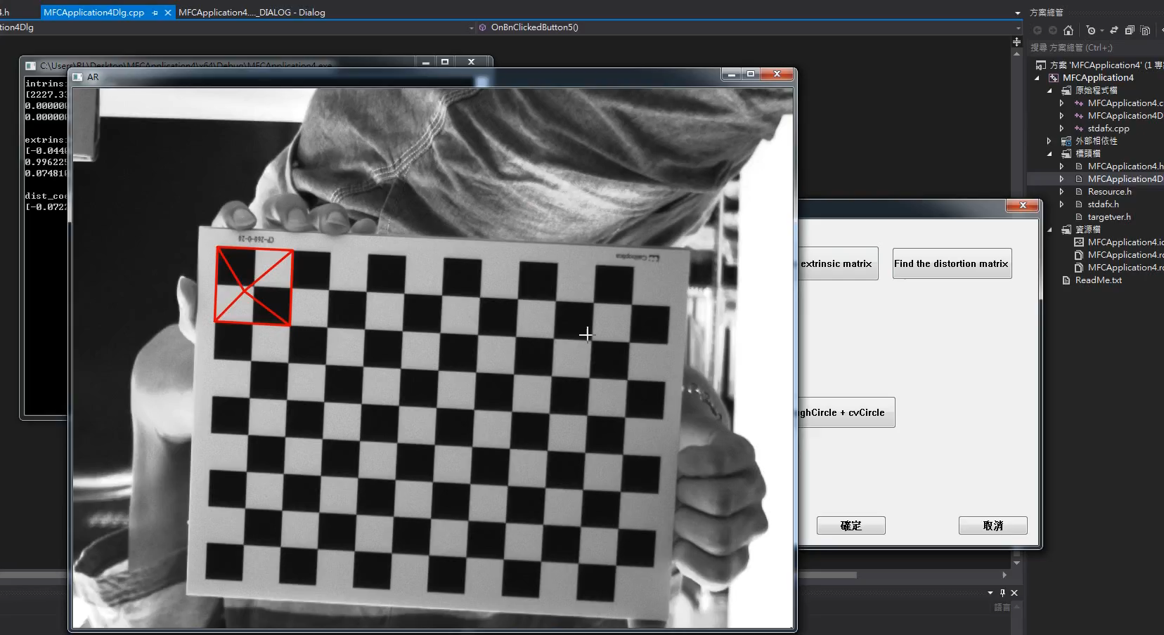
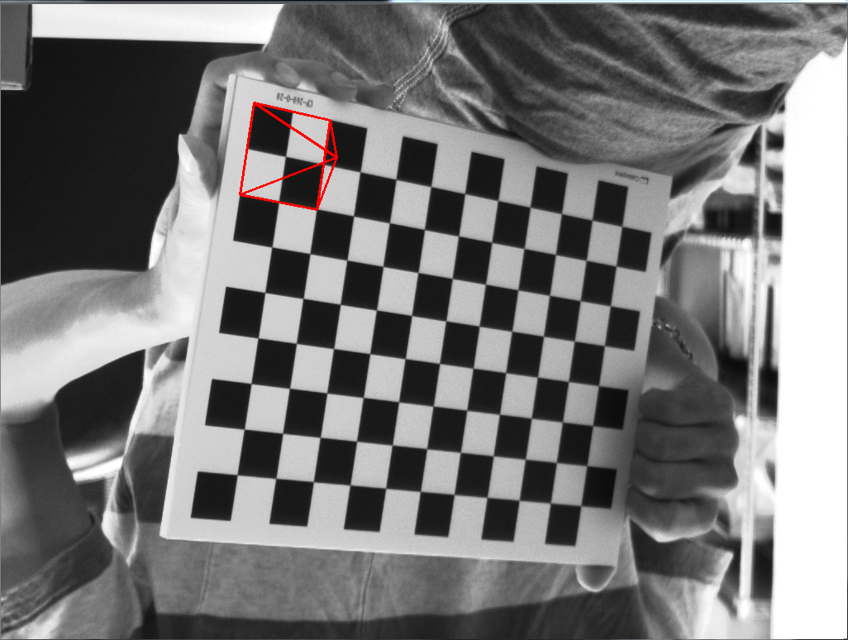
2. Augmented Reality (出題：Jang)
Given: Intrinsic and extrinsic parameters, distortion coefficients, and 5 images: 1~5.bmp
Q: 1) Draw a “pyramid” on the chessboard images (1.bmp to 5.bmp), then
2) Click the button ”2” to show the pyramid on the picture. Show each
picture for 0.5 seconds (total 5 images)
Hint : Textbook Chapter 11, p.370~402
3D Object coordinates:
Vertex (0, 0, -2)
Corners(1, 1, 0)(1, -1, 0)(-1, -1, 0)(-1, 1, 0)
Demo video:
(0,0,0)
(0, 0, -2)
(-1, -1, 0)
(1, -1, 0)
(-1, 1, 0)
(1, 1, 0)
17

Slide 18
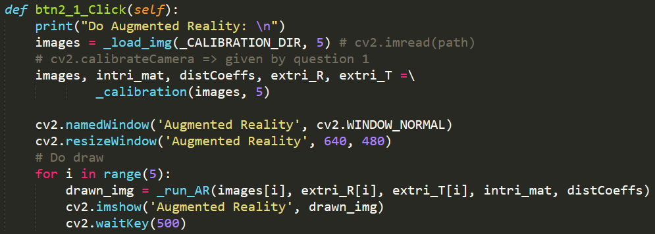
2. Augmented Reality - Solution(1/3) (解題：Jimmy)
Answer:
Step1. Use the intrinsic, extrinsic, distortion matrix calculated from Q1
retval, intri_mat, distCoeffs, extra_R, extra_T =
cv2.calibrateCamera(object_points, image_points, image_size, None, None)
Function for drawing pyramid
Reference:
https://docs.opencv.org/2.4/modules/calib3d/doc/camera_calibration_and_3d_reconstruction.html
https://www.programcreek.com/python/example/89414/cv2.projectPoints

Slide 19
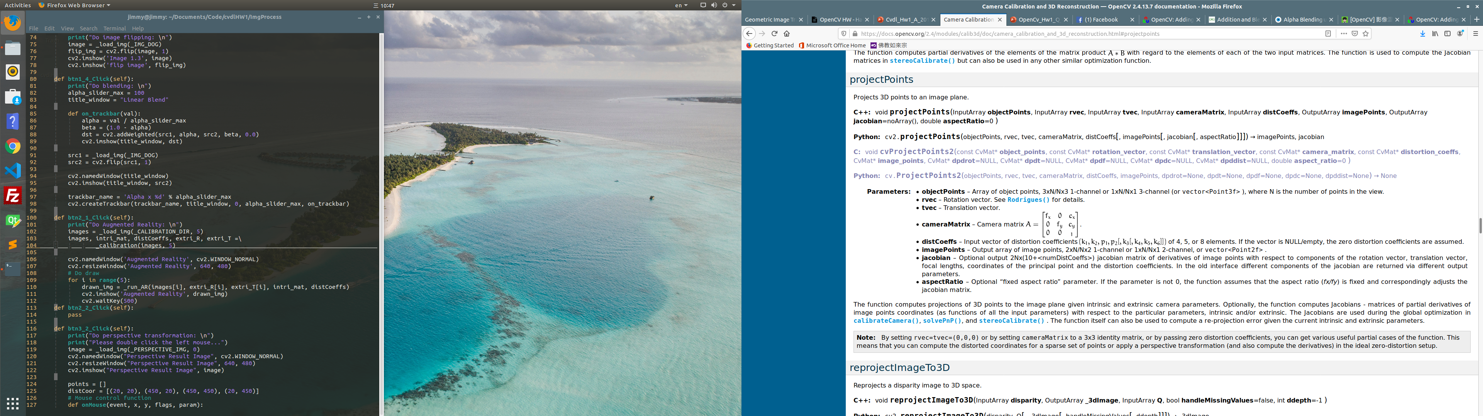
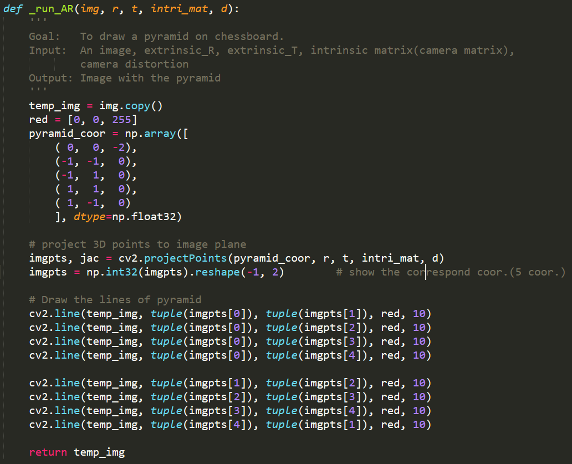
2. Augmented Reality - Solution(2/3) (解題：Jimmy)
Answer:
Step2. Project pyramid points into 2-D point on image
Output:

Slide 20
2. Augmented Reality - Solution(3/3) (解題：Jimmy)
Answer:
Step3. Draw the pyramid using red lines.
Optional, not use here
3D Object coordinates:
Vertex (0, 0, -2)
Corners(1, 1, 0)(1, -1, 0)(-1, -1, 0)(-1, 1, 0)
(0, 0, -2)
(-1, -1, 0)
(1, -1, 0)
(-1, 1, 0)
(1, 1, 0)

Slide 21
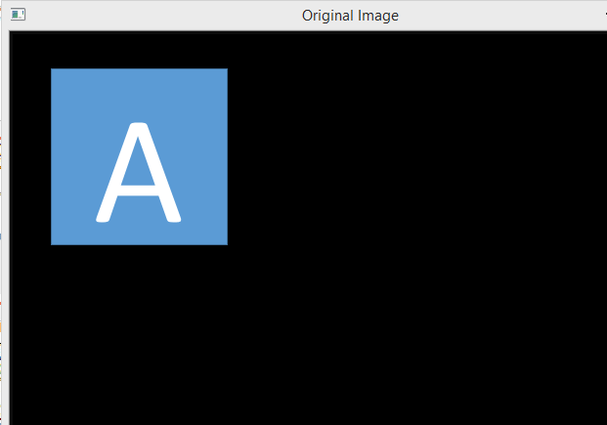
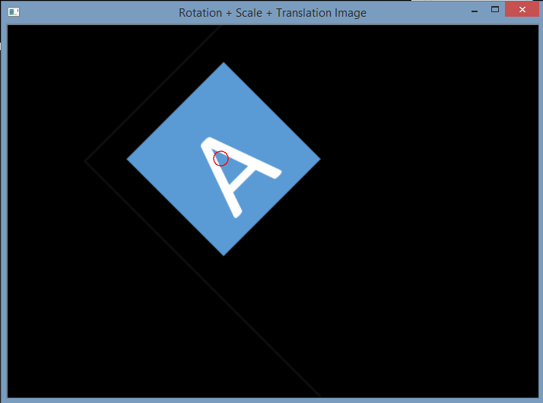
3.1 Transforms: Rotation, Scaling, Translation (出題：YiYuan)
Given: OriginalTransform.png image
Q: 1) Click button “3.1”, OriginalTransform.png should be showed.
2) Please rotate, scale and translate the small squared image (as Figure 3.1) with following parameters (should be entered in the GUI):
(1) Angle = 45⁰ (counter-clockwise)
(2) Scale = 0.8,
(3) Translation with:
x_{new} = x_{old} + 150 pixels = 130 + 150 = 280
y_{new} = y_{old} + 50 pixels = 125 + 50 = 175
Point C (130,125) is center of small square image
Hint :
OpenCV Textbook Chapter 12 (p. 407 ~ p. 412)
warpAffine(…);
EX:
Small square image
C (130,125)
C (280,175)
45⁰
Figure 3.1 Original Image
Figure 3.2 Rotation, Scale and Translation Image

Slide 22
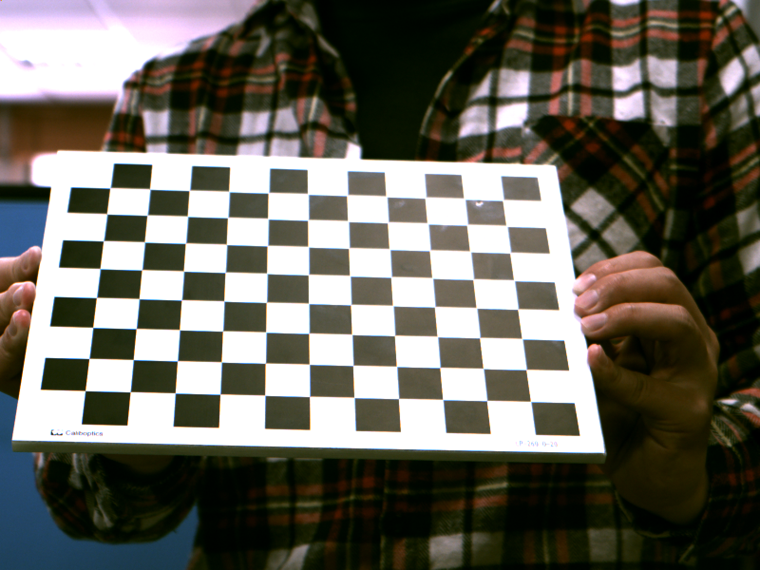
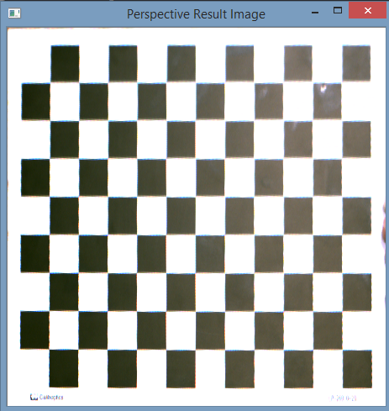
3.2 Perspective Transformation (出題：YiYuan)
Given: OriginalPerspective.png image
Q: Use OpenCV functions to project the image
1) Click button “3.2” to show image in the new window. Then do:
Click 4 points showed in console window. (start from top-left corner of the original image, and then click clock-wise)
Warp the original image to the location (20,20), (20,450), (450,450), (450,20). Open second window to show the result.
Hint:
Textbook Chapter 6, p. 170~171
mouse callback function (p.96)
(20,20)
(450,20)
(20,20)
y
1
2
x
4
3
Original Perspective
(20,450)
Perspective Image
(450,450)

Slide 23
imread
Related work(1/5) (解題：Bill)
How to save and display an image with opencv?
import cv2
img = cv2.imread('image.jpg', cv2.IMREAD_GRAYSCALE)
cv2.imshow('My Image', img)
imread(image path,image format)
image format:
cv2.IMREAD_COLOR
Default value, which reads the picture of three channels called RGB and ignores the channel of transparency.
cv2.IMREAD_GRAYSCALE
Read the image in grayscale format.
cv2.IMREAD_UNCHANGED
Read all the channels in the image,including the channel of transparency.

Slide 24
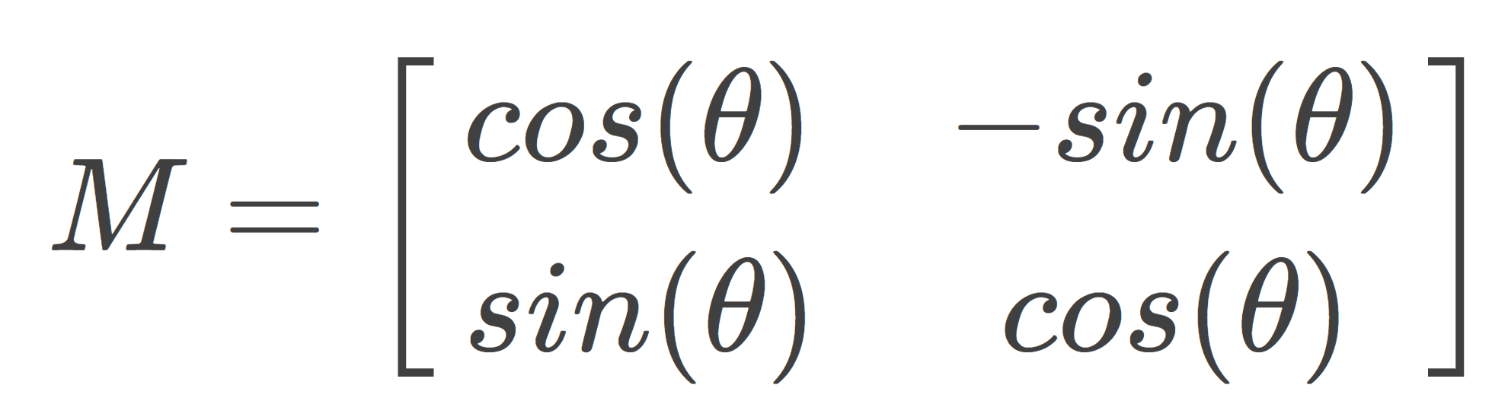
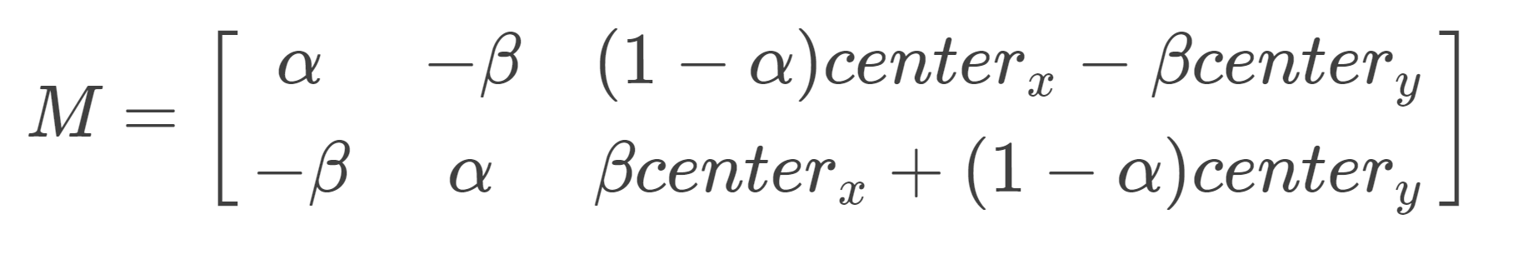
getRotationMatrix2D
Related work(2/5) (解題：Bill)
The rotation matrix of an image is:
In order to be able to rotate at any position, opencv takes another approach:

Slide 25
getRotationMatrix2D
Related work(3/5) (解題：Bill)
M = cv2.getRotationMatrix2D((cols/2,rows/2),45,1)
res = cv2.warpAffine(img,M,(rows,cols))
RotationMatrix=getRotationMatrix2D(Rotation center , Rotation angle , scaling)l
warpAffine(Original picture, RotationMatrix,(rows,cols))

Slide 26
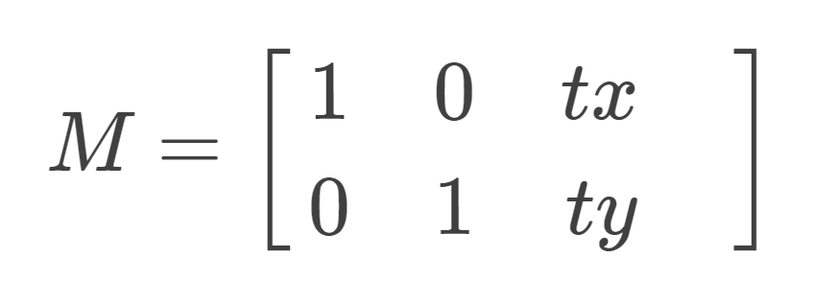
Image panning
Related work(4/5) (解題：Bill)
In order to panning an image ,we use the following matrix.
tx and ty are the ‘movement’ of x-direction and y-direction.
M = np.array([[1, 0, x], [0, 1, y]])
img = cv2.warpAffine(img, M, (x, y))

Slide 27
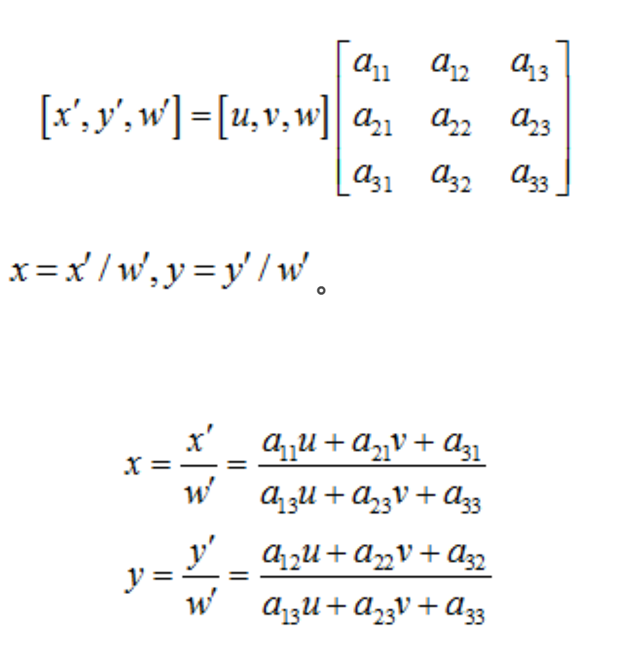
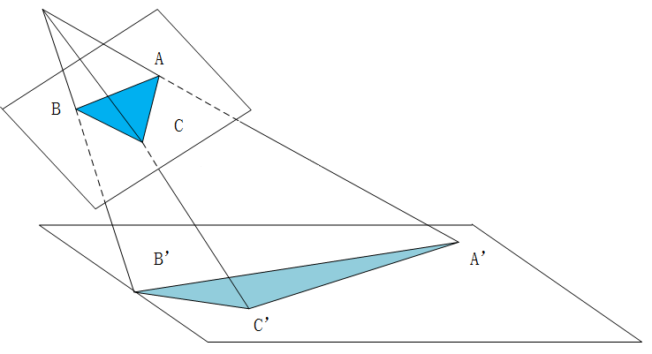
getPerspectiveTransform(Original location, Converted position)
Related work(5/5) (解題：Bill)
Perspective Transformation Matrix
The general formula for perspective transformation is:
The transformed coordinates x, y are:
After the expansion:
M = cv2.getPerspectiveTransform(Original location, Converted position)
img = cv2.warpPerspective(Original Image, M, (x, y))

Slide 28
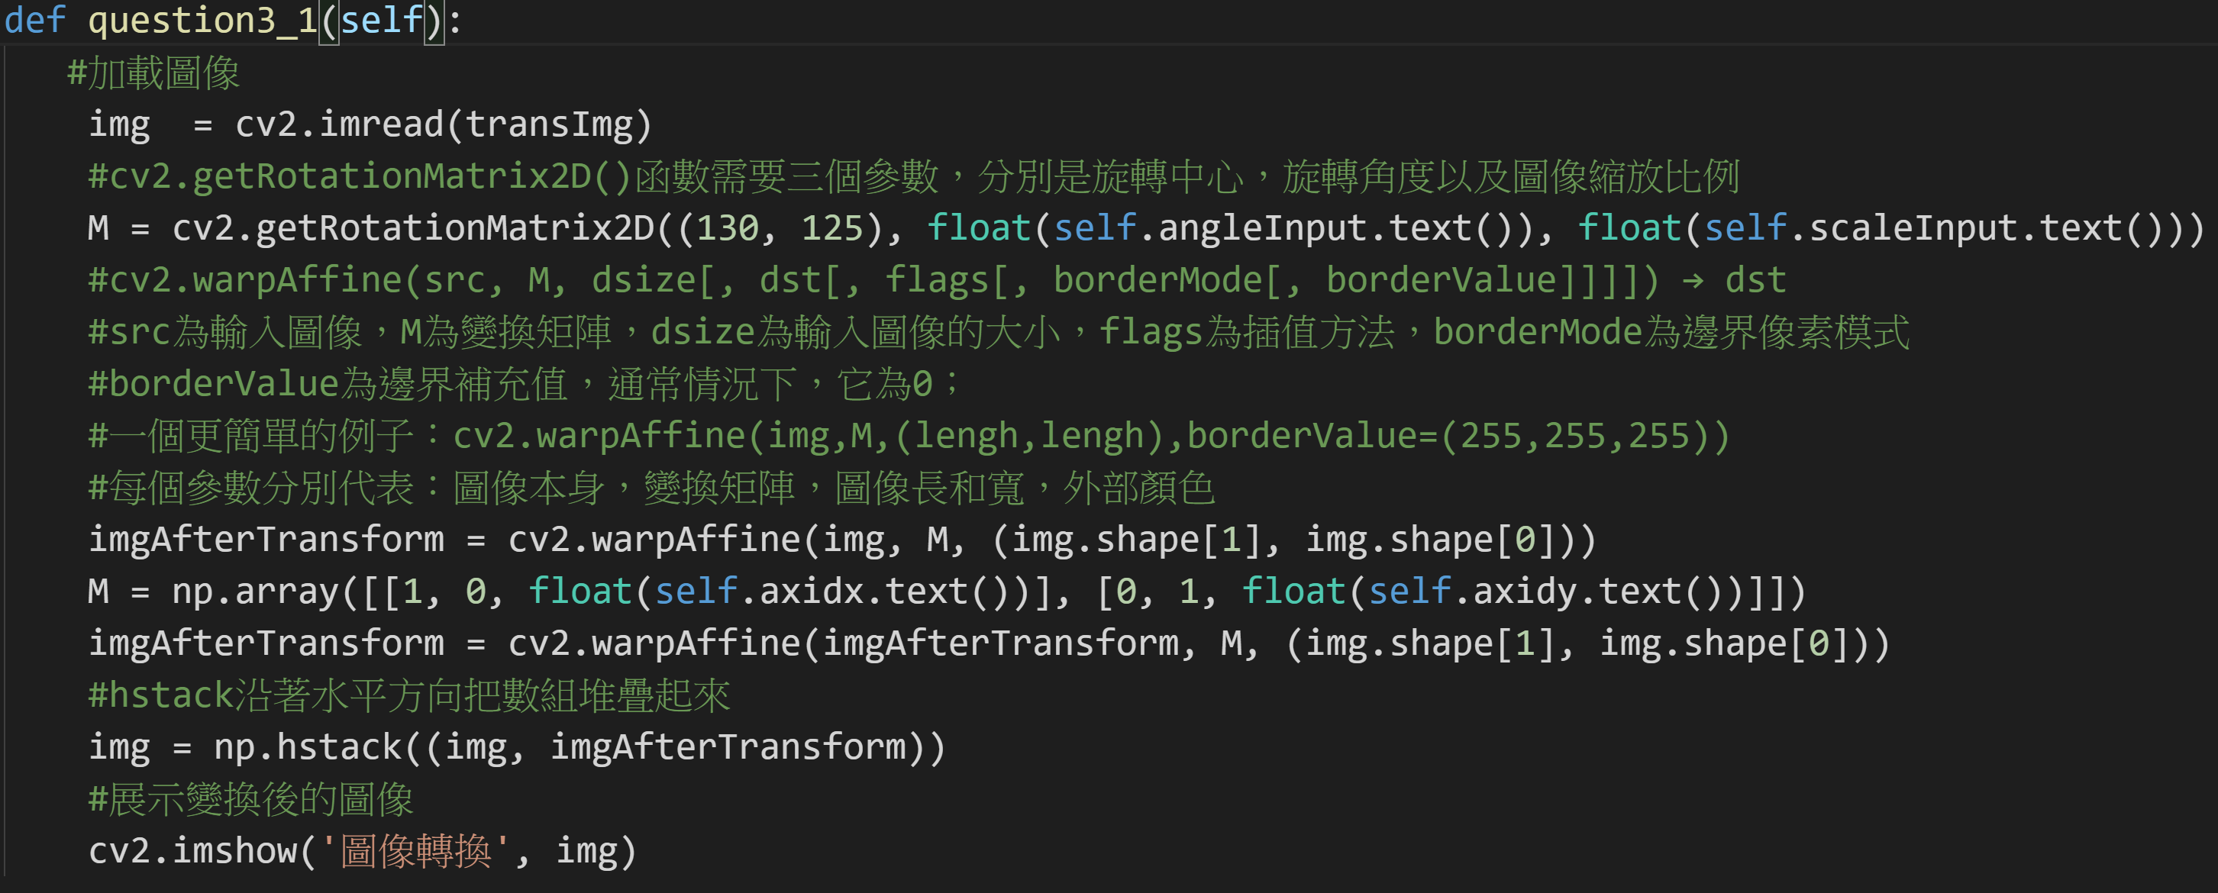
3.1 Transforms: Rotation, Scaling, Translation (解題：Bill)
A:

Slide 29
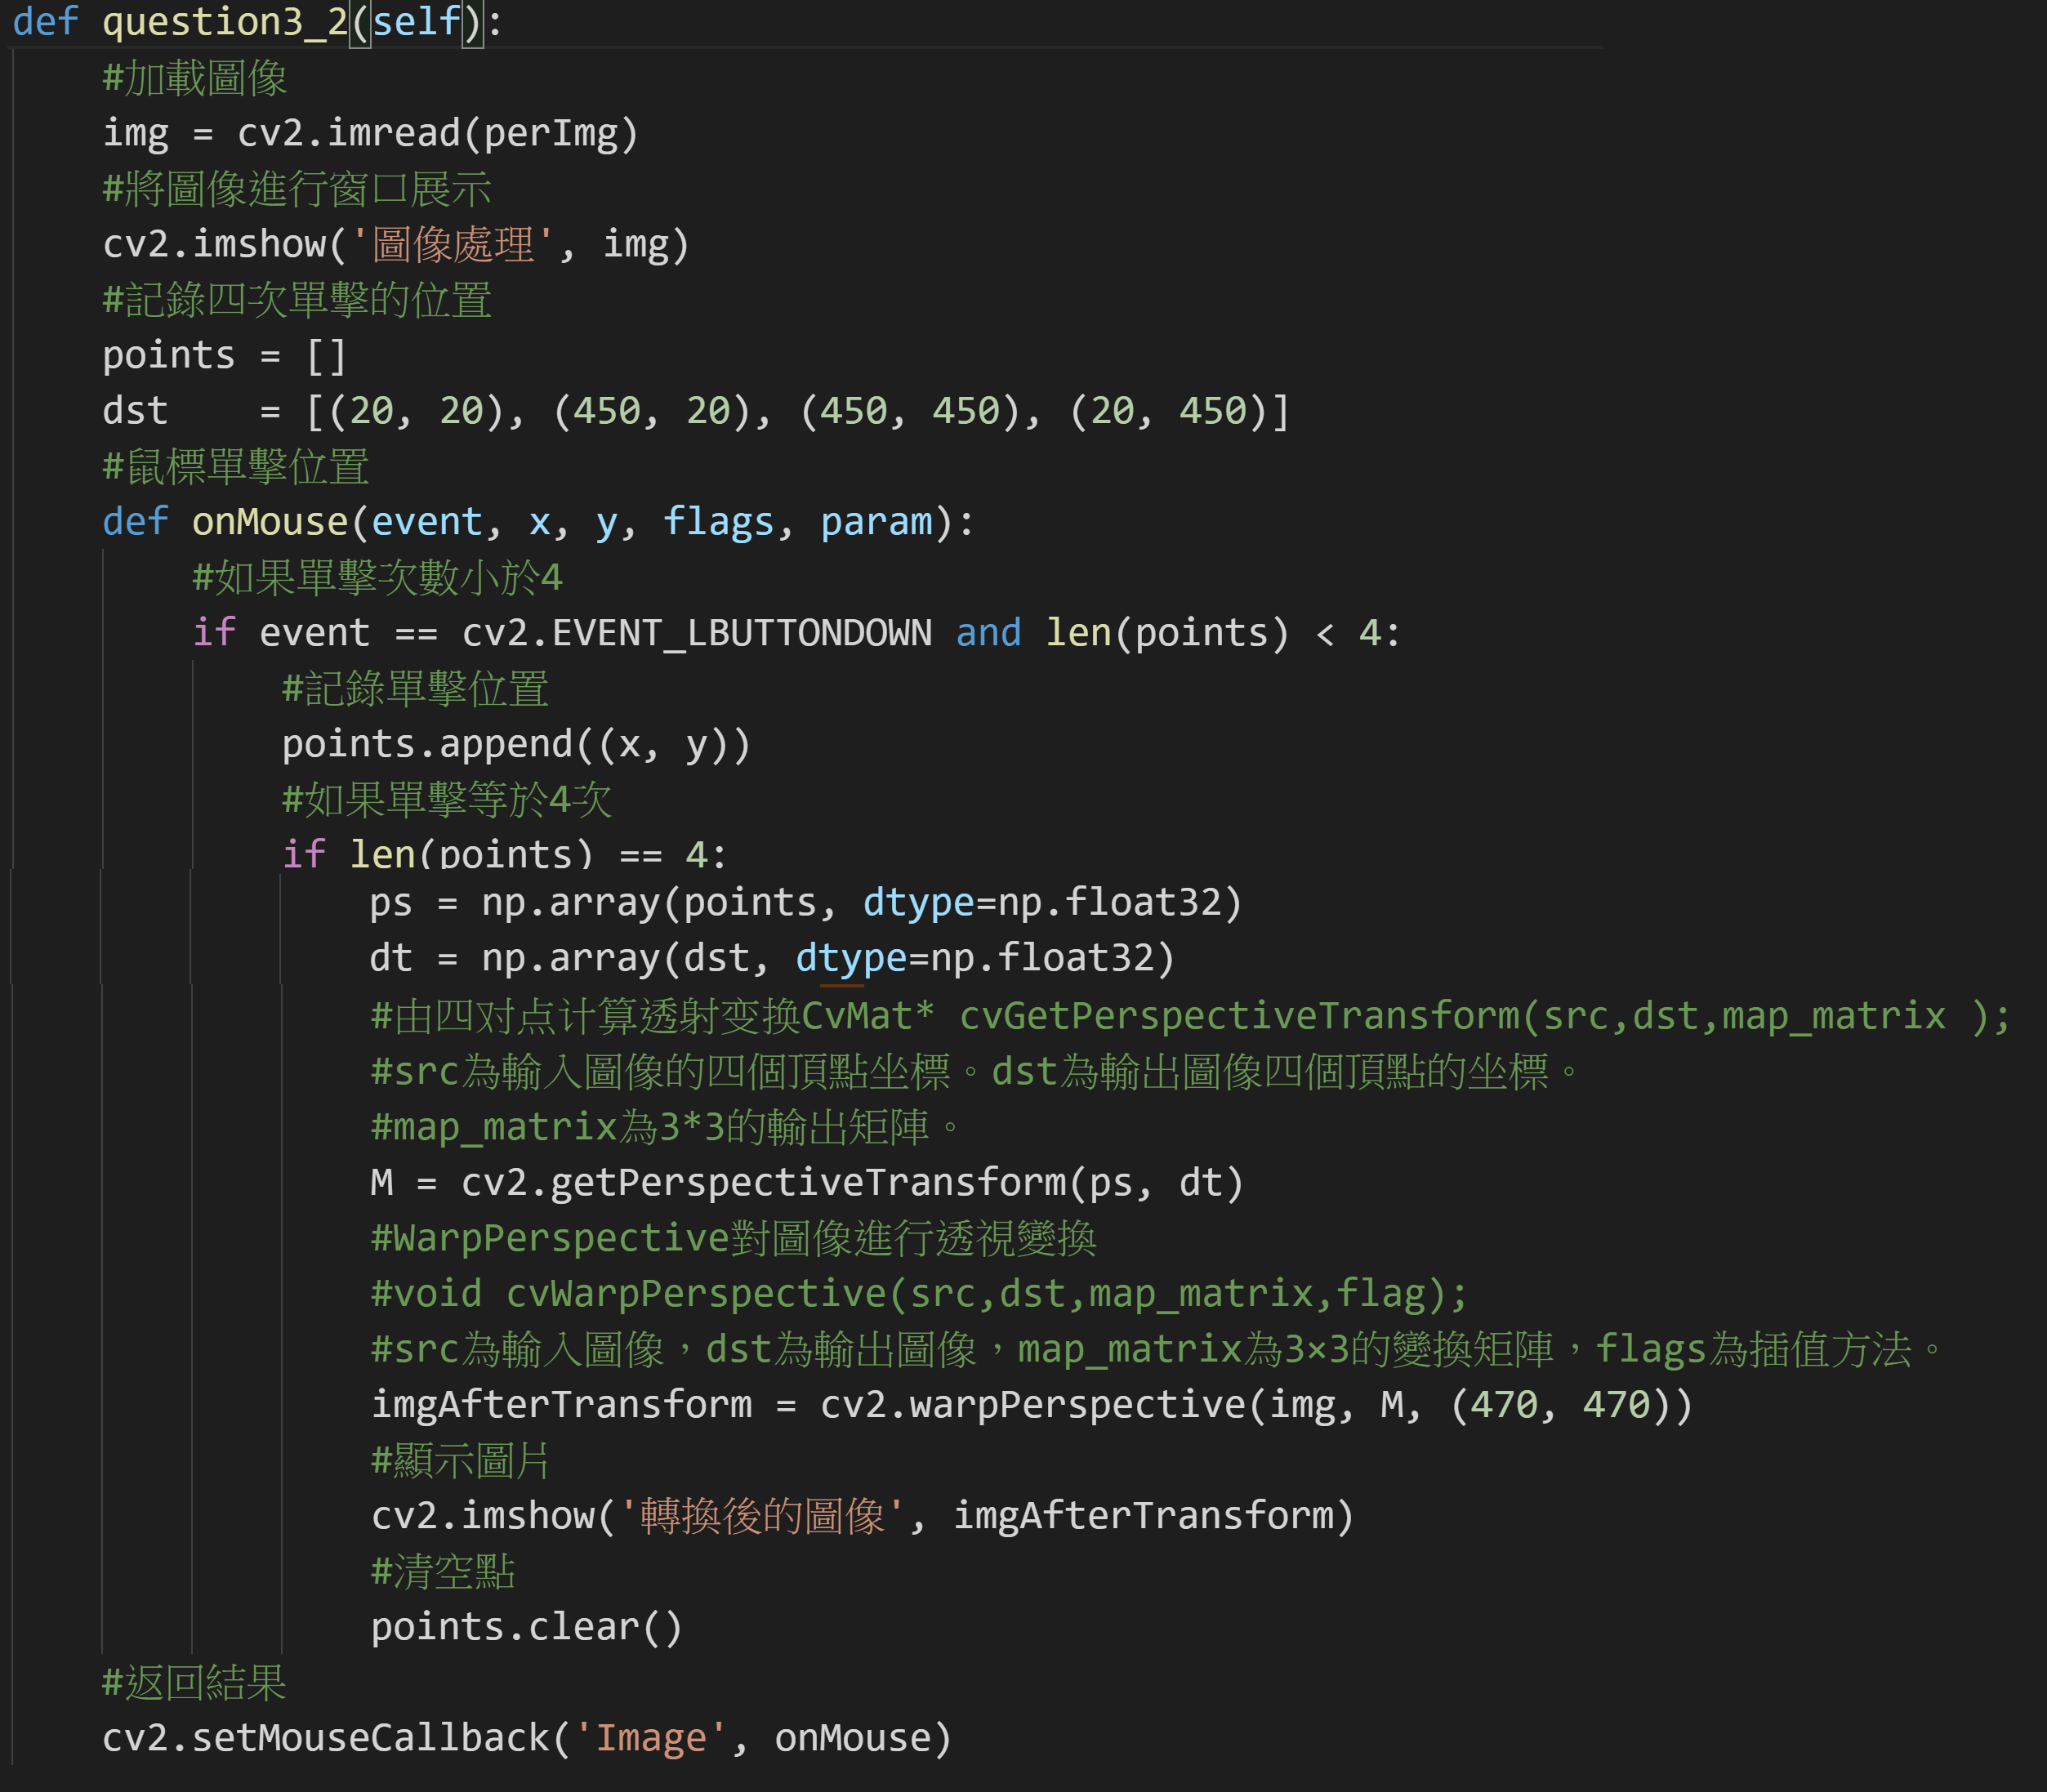
3.2 Perspective Transformation (解題：Bill)
A:

Slide 30
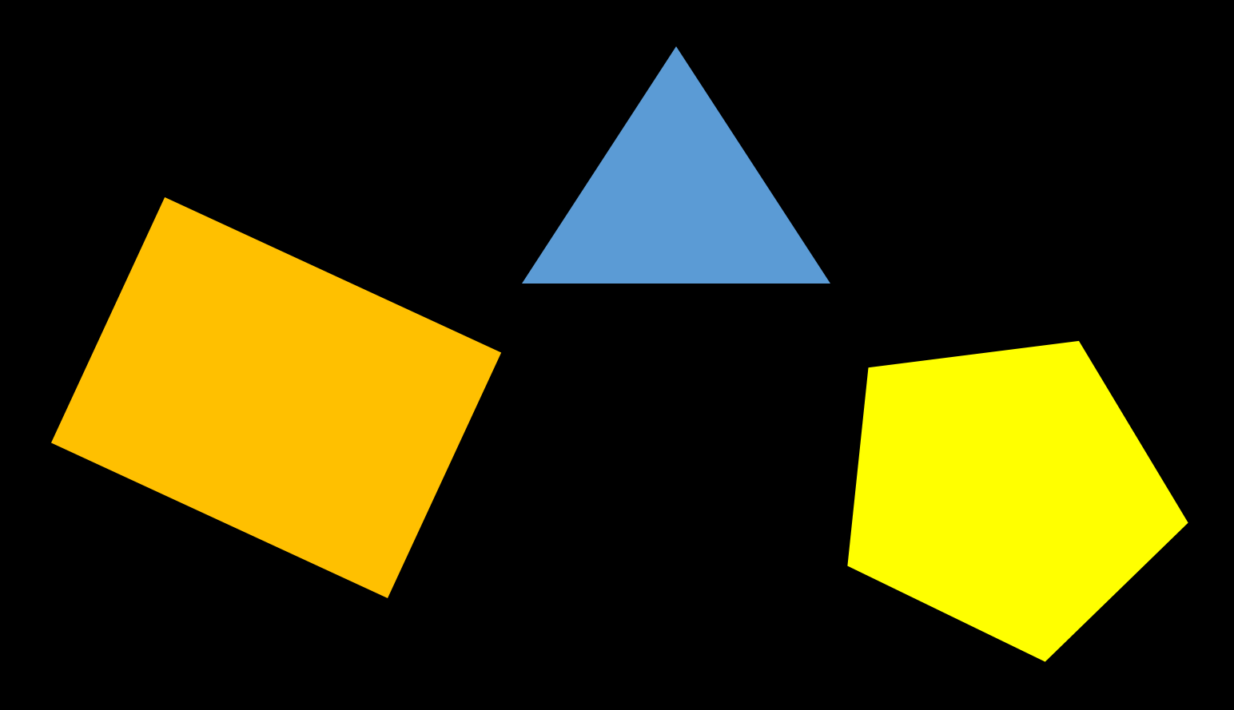
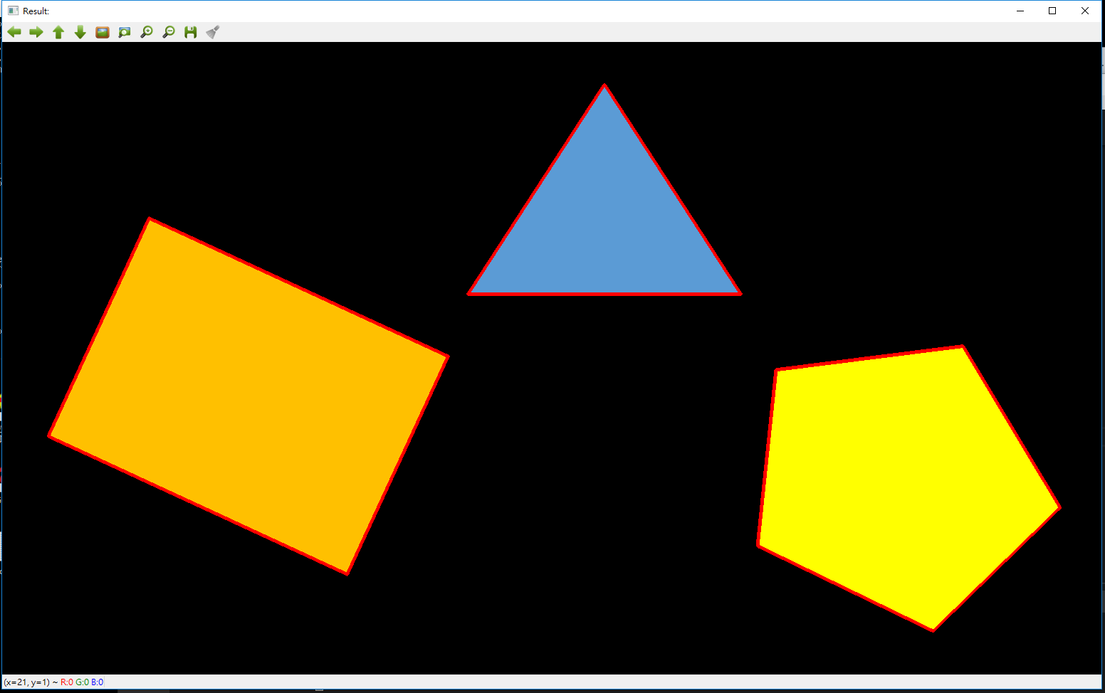
4.0 Find Contour (出題：Rex)
Given: Contour.png image
Q: Use OpenCV functions to find all the contours in the image
1) Click button “4.1” to show image in the new window. Then draw the edges by red.
Hint:
Textbook Chapter 8, p. 234~241

Slide 31
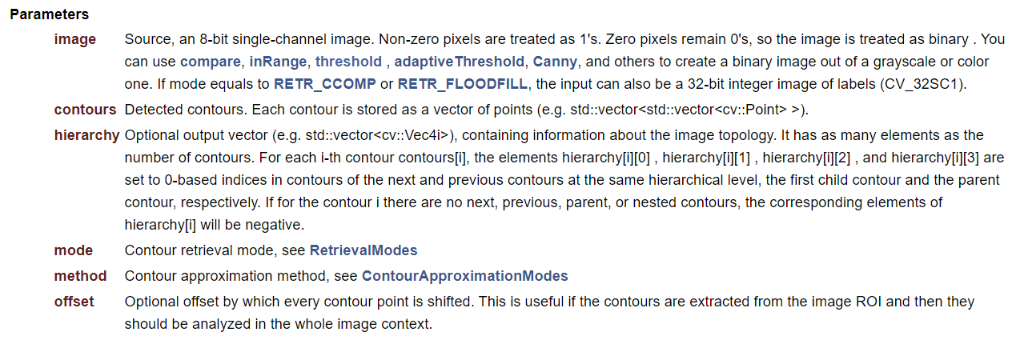
4.0 Find Contour (解題：Oran)
A:
import numpy as np
import cv2 as cv
im = cv.imread('test.jpg’)
imgray = cv.cvtColor(im, cv.COLOR_BGR2GRAY)
ret, thresh = cv.threshold(imgray, 127, 255, 0)
contours, hierarchy = cv.findContours(thresh,
cv.RETR_TREE, cv.CHAIN_APPROX_SIMPLE)
讀取圖片
轉換為灰度圖（颜色空间转换函数）
对灰度图像进行阈值操作得到二值图像（二值化函數）
對二值圖像操作得到輪廓的點陣

Slide 32
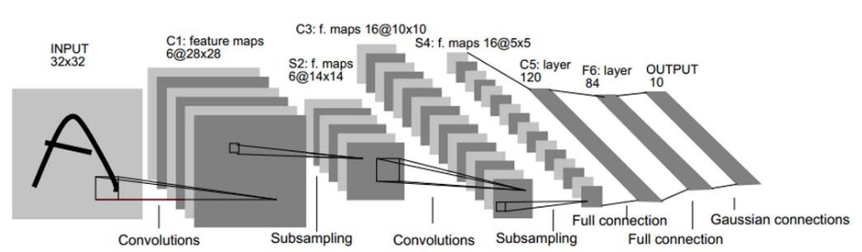
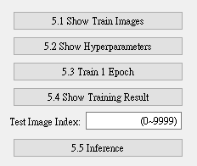
5.0 Train Cifar-10 Classifier Using LeNet-5 (出題：Michael)
Learn to construct LeNet-5 and train it by using data Cifar-10.
Environment Requirement
Python 3.7
Tensorflow 2.0 / PyTorch 1.3.0
opencv-contrib-python 3.4.2.17
Matplotlib 3.1.1
Reference
Gradient-Based Learning Applied to Document Recognition (http://yann.lecun.com/exdb/publis/pdf/lecun-01a.pdf) (LeNet)
Cifar-10 (https://www.cs.toronto.edu/~kriz/cifar.html)

Slide 33
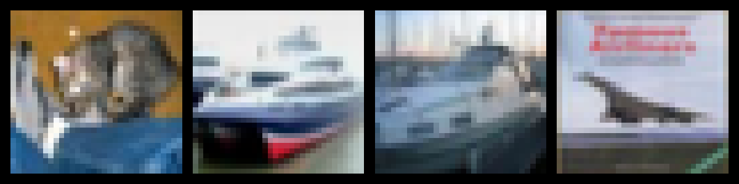
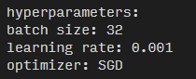
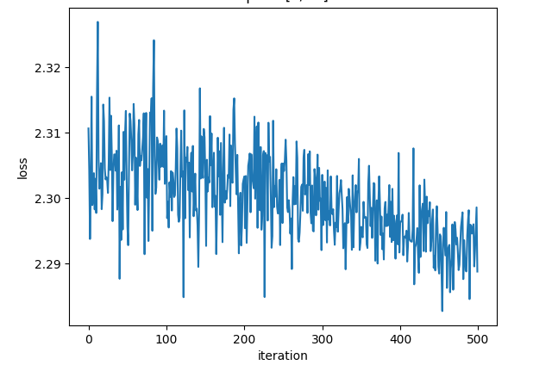
5.1 Load Cifar-10 training dataset and randomly show 10 images and labels respectively. (10%)
5.2 Print out training hyperparameters (batch size, learning rate, optimizer). (10%)
5.3 Train 1 epoch from initial status and show training loss at the end of the epoch. (10%)
…
Label: cat ship ship airplane …
(Record loss per iteration)

Slide 34
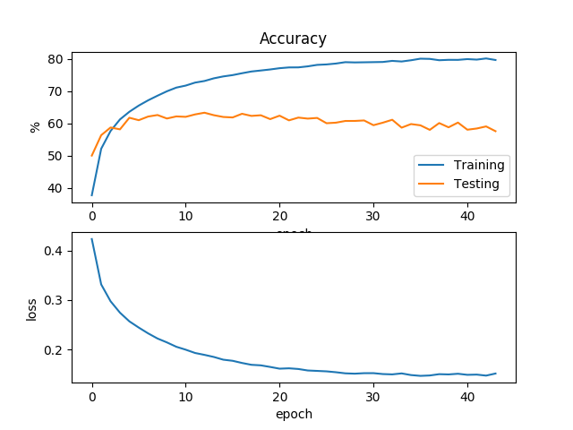
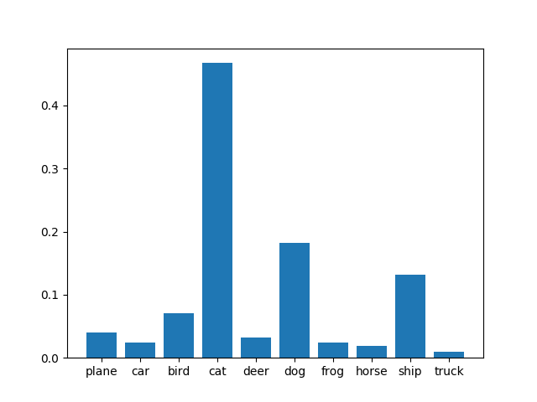
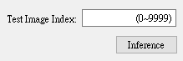
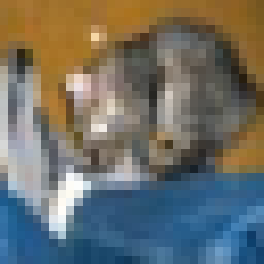
5.4 Train your model at least 50 epochs by your own computer, save your model and take a screenshot of your training loss and accuracy. (10%)
5.5 Load your model trained at 5.4. Let us choose one test image from Cifar-10 test images. Then inference the image, show image and estimate this test image. (10%)
(Record accuracy/loss per epoch)
Show image
Estimation result

Slide 35
5.0 Train Cifar-10 Classifier Using LeNet-5
(解題：Kevin)
Libraries
tensorflow
tensorflow_datasets
Automatic download and load dataset
opencv-python
matplotlib
Plot line chart and histogram
Pyqt5
GUI
(optional) absl
Command line arguments parsing

Slide 36
5.1 Load Cifar-10 training dataset and randomly show 10 images and labels respectively (10%) (1/3)
import tensorflow_datasets as tfds
ds = tfds.load('cifar10', in_memory=True, as_supervised=True)
train_data, test_data = ds['train'], ds['test']
Description:
tfds.load(name, ...)
- Loads the named dataset into a tf.data.Dataset
Reference:
https://www.tensorflow.org/datasets/api_docs/python/tfds
https://www.tensorflow.org/api_docs/python/tf/data/Dataset#map

Slide 37
5.1 Load Cifar-10 training dataset and randomly show 10 images and labels respectively (10%) (2/3)
import random
_LABELS = ['airplane', 'automobile', 'bird', 'cat', 'deer',
'dog', 'frog', 'horse', 'ship', 'truck']
s = random.sample(list(train_data), 10)
# s => [(image1, label1), ... , (image10, label10)]
s = tfds.as_numpy(s)
images, labels = zip(*s)
images = [cv2.resize(i, (128, 128)) for i in images]
labels = [_LABELS[l] for l in labels]
Description:
list(iterable)
- Convert something into python list (tf.data.Dataset here)
random.sample(sequence, k)
- Return a k length list of unique elements chosen from the sequence
tfds.as_numpy(...)
- Convert something into numpy data structure
zip(*iterables)
- Make an iterator that aggregates elements from each of the iterables
Reference:
https://www.tensorflow.org/datasets/api_docs/python/tfds
https://www.tensorflow.org/api_docs/python/tf/data/Dataset#map

Slide 38
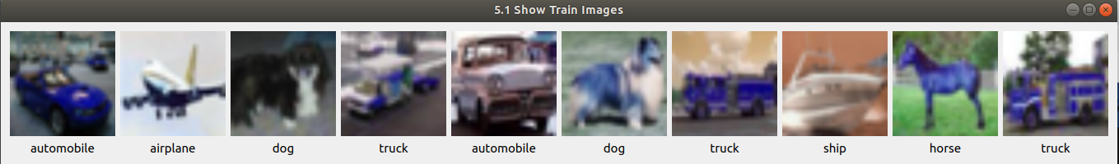
5.1 Load Cifar-10 training dataset and randomly show 10 images and labels respectively (10%) (3/3)
Result:

Slide 39
5.2 Print out training hyperparameters (batch size, learning rate, optimizer) (10%) (1/2)
print('hyperparameters:')
print('batch size:', 32)
print('learning rate:', 0.001)
print('optimizer:', 'SGD')
Reference:
https://docs.python.org/3.7/library/index.html

Slide 40
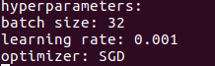
5.2 Print out training hyperparameters (batch size, learning rate, optimizer) (10%) (2/2)
Result:

Slide 41
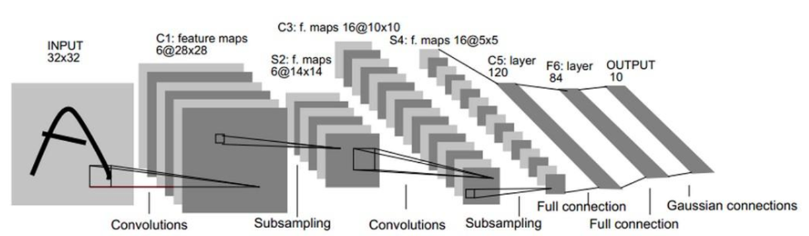
5.3 Train 1 epoch from initial status and show training loss at the end of the epoch. (10%) (1/4)
from tensorflow import keras
model = keras.Sequential([
keras.layers.Conv2D(6, (5, 5), input_shape=(32, 32, 3)),
keras.layers.AveragePooling2D(),
keras.layers.Activation('tanh'),
keras.layers.Conv2D(16, (5, 5)),
keras.layers.AveragePooling2D(),
keras.layers.Activation('tanh'),
keras.layers.Conv2D(120, (5, 5)),
# Note: If the input to the Dense layer has a rank greater than 2
# then it is flattened prior to the initial dot product with kernel.
keras.layers.Dense(84, activation=tf.nn.tanh),
keras.layers.Dense(10, activation=tf.nn.softmax)
])

Slide 42
5.3 Train 1 epoch from initial status and show training loss at the end of the epoch. (10%) (2/4)
optimizer = keras.optimizers.SGD(learning_rate=1e-3)
loss = keras.losses.get('sparse_categorical_crossentropy')
train_data = train_data.batch(batch_size, drop_remainder=True)
data_length = len(list(train_data)) # how many batches
losses = [] # container to save losses
Description:
Dataset.batch(batch_size, drop_remainder=False)
- Combines consecutive elements of this dataset into batches
Reference:
https://www.tensorflow.org/api_docs/python/tf/data/Dataset#batch

Slide 43
5.3 Train 1 epoch from initial status and show training loss at the end of the epoch. (10%) (3/4)
for i, batch in enumerate(train_data.take(-1)):
with tf.GradientTape() as tape:
y = model(batch[0]) # batch[0] => images
l = loss(batch[1], y) # batch[1] => labels
grads = tape.gradient(l, model.trainable_variables)
optimizer.apply_gradients(zip(grads, model.trainable_variables))
losses += [tf.reduce_mean(l).numpy()]
Description:
Dataset.take(count)
- Creates a Dataset with at most count elements from this dataset
- If count is -1, the new dataset will contain all elements of this dataset
tf.GradientTape
- Record operations for automatic differentiation
tf.GradientTape.gradient()
- Computes the gradient using operations recorded in context of this tape
Reference:
https://www.tensorflow.org/api_docs/python/tf/data/Dataset#batch
https://www.tensorflow.org/api_docs/python/tf/GradientTape

Slide 44
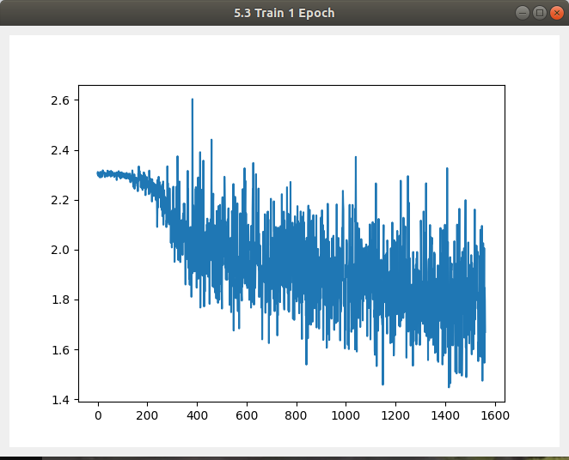
5.3 Train 1 epoch from initial status and show training loss at the end of the epoch. (10%) (4/4)
Result:

Slide 45
5.4 Train your model at least 50 epochs by your own computer, save your model and take a screenshot of your training loss and accuracy. (10%) (1/3)
ckpt = tf.train.Checkpoint(model=model)
manager = tf.train.CheckpointManager(ckpt, 'log/')
latest_checkpoint = manager.latest_checkpoint
if latest_checkpoint:
ckpt.restore(latest_checkpoint)
Description:
tf.train.Checkpoint(model=model)
- Groups trackable objects, saving and restoring them
Reference:
https://www.tensorflow.org/api_docs/python/tf/train/Checkpoint
https://www.tensorflow.org/api_docs/python/tf/train/CheckpointManager

Slide 46
5.4 Train your model at least 50 epochs by your own computer, save your model and take a screenshot of your training loss and accuracy. (10%) (2/3)
metric = keras.metrics.SparseCategoricalAccuracy() accuracy = []
...
grads = tape.gradient(l, model.trainable_variables)
optimizer.apply_gradients(zip(grads, model.trainable_variables))
metric.update_state(batch[1], y) # Accumulates metric statistics
...
losses += [tf.reduce_mean(l).numpy()]
accuracy += [metric.result().numpy()]
Description:
keras.metrics.SparseCategoricalAccuracy
- Calculates how often predictions matches integer labels.
Reference:
https://www.tensorflow.org/api_docs/python/tf/keras/metrics/SparseCategoricalAccuracy

Slide 47
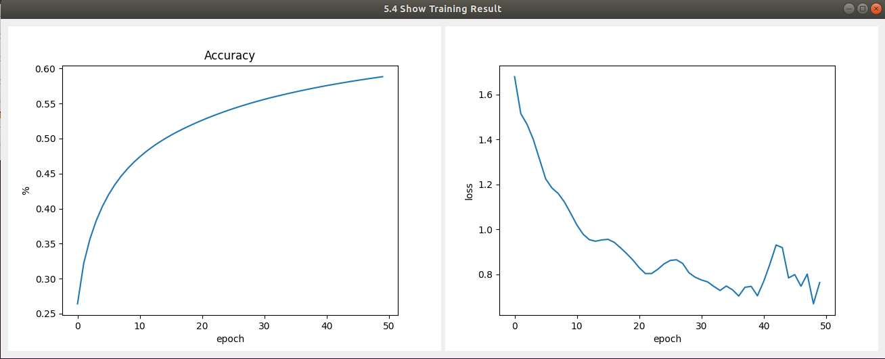
5.4 Train your model at least 50 epochs by your own computer, save your model and take a screenshot of your training loss and accuracy. (10%) (3/3)
Result:

Slide 48
5.5 Load your model trained at 5.4. Let us choose one test image from Cifar-10 test images. Then inference the image, show image and estimate this test image. (10%) (1/2)
# expand one dimension (32, 32, 3) => (1, 32, 32, 3)
image = image[np.newaxis]
# calculate probability by your model
y = model(y)
# squeeze dimension (1, 10) => (10,)
y = np.squeeze(y)

Slide 49
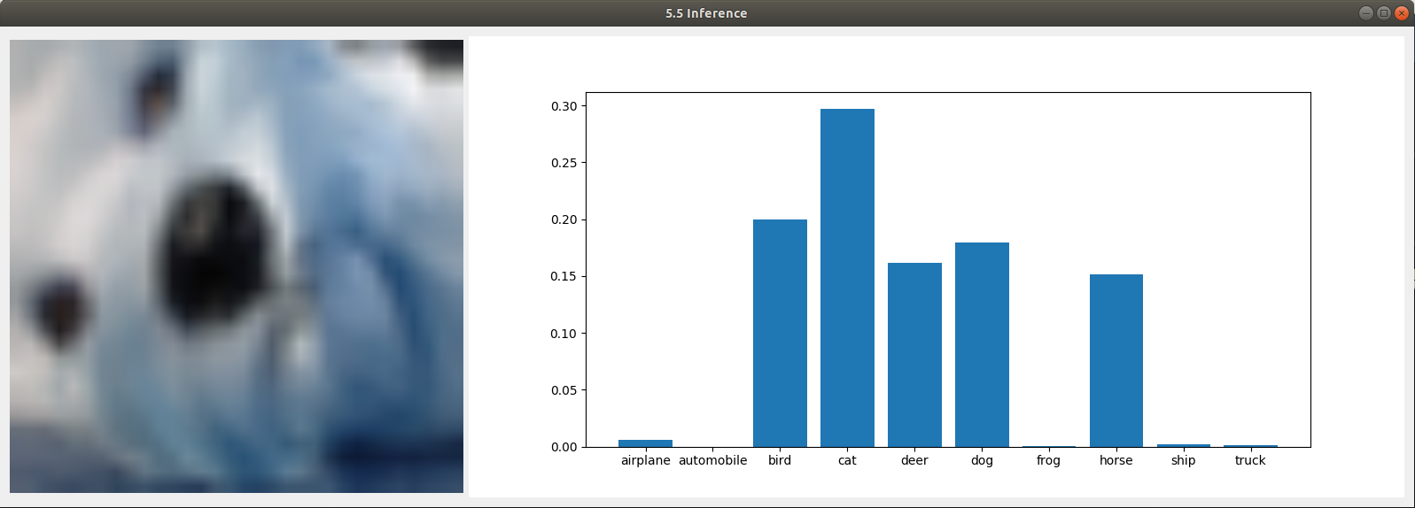
5.5 Load your model trained at 5.4. Let us choose one test image from Cifar-10 test images. Then inference the image, show image and estimate this test image. (10%) (2/2)
Result:

